Slide 1
Digital Images

Slide 2
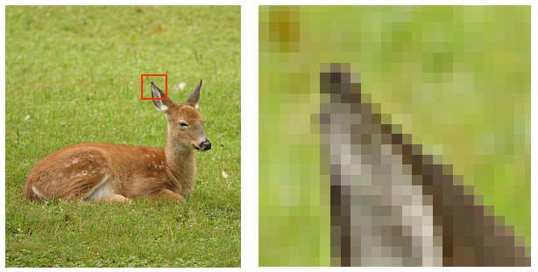
Digital Image
a grid of squares, each of which contains a single color
1 pixel
each square is called a pixel (for picture element)
2
Notes:
2

Slide 3
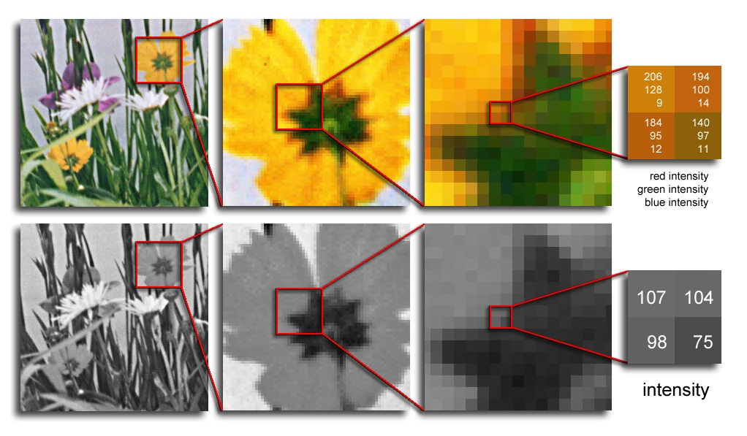
Digital Image
Color images have 3 values per pixel; monochrome images have 1 value per pixel.
a grid of squares, each of which contains a single color
each square is called a pixel (for picture element)
3
Notes:
3

Slide 4
Digital Image
A set of pixels (picture elements, pels)
Pixel means
  pixel coordinate
  pixel value
  or both
Both coordinates and value are discrete

Slide 5
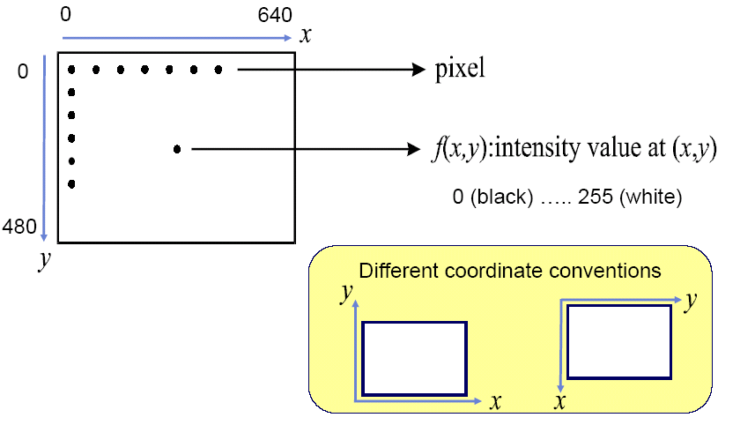
Example
640 x 480 8-bit image

Slide 6
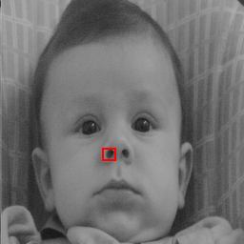
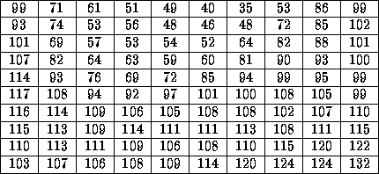
DIGITAL IMAGE REPRESENTATION
PIXEL VALUES IN HIGHLIGHTED REGION
A set of number in 2D grid
CAMERA
DIGITIZER
Samples the analog data and digitizes it.

Slide 7
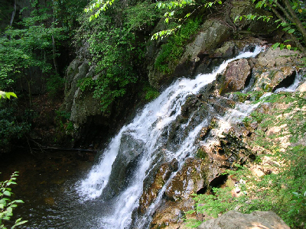
What is a Digital Image? (cont…)
Common image formats include:
  1 sample per point (B&W or Grayscale)
  3 samples per point (Red, Green, and Blue)
For most of this course we will focus on grey-scale images

Slide 8

GRAY LEVEL
WE CALL THE INTENSITY OF A MONOCHROME IMAGE f AT COORDINATE (x, y) THE GRAY LEVEL (L) OF THE IMAGE AT THAT POINT.
Thus, l lies in the range
L_{min} is positive and L_{max} is finite.
Gray scale = [L_{min}, L_{max}]
Common practice, shift the interval to [0,L] : 0 = black, L-1 = white

Slide 9
Digital Image Representation
Image Size
  Number of bits required to store an image
  Image having 2^{k} intensity levels
    k – bit image
    256 intensity levels – 8 bit image
9
Notes:
9

Slide 10
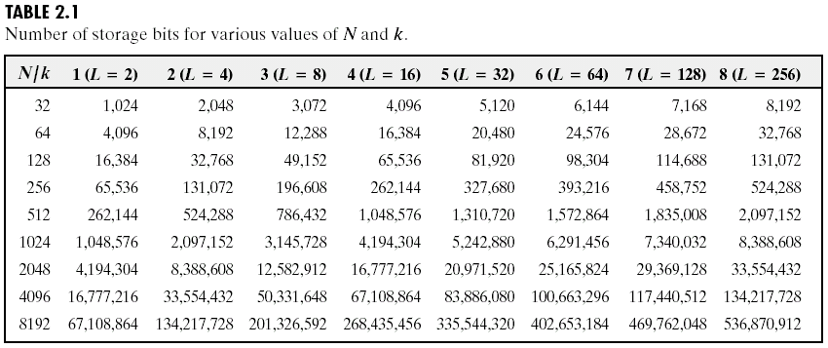
Image Size

Slide 11
Spatial & Gray Level Resolution

Slide 12
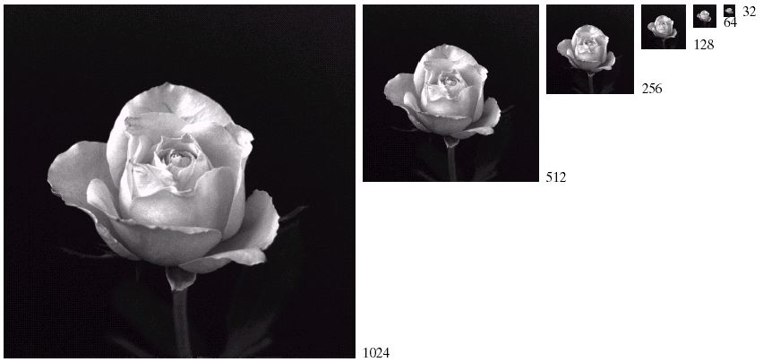
Spatial Resolution
12
Notes:
12

Slide 13
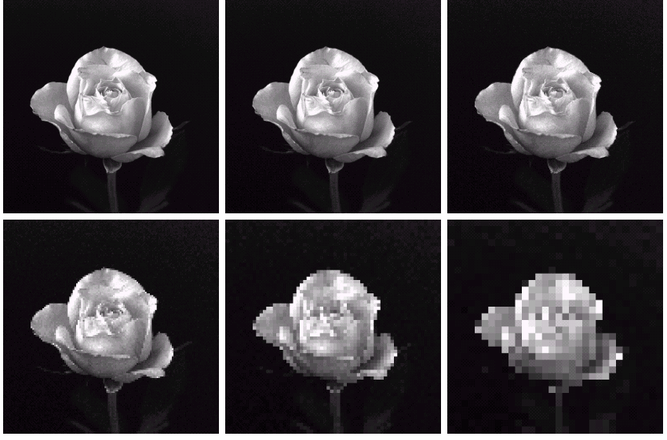
Spatial Resolution
13
Notes:
13

Slide 14
Intensity Level Resolution
Intensity level resolution refers to the number of intensity levels used to represent the image
  The more intensity levels used, the finer the level of detail in an image
  Intensity level resolution is usually given in terms of the number of bits used to store each intensity level
14
Notes:
14

Slide 15
Intensity Level Resolution
Number of Bits
Number of Intensity Levels
Examples
1
2
0, 1
2
4
00, 01, 10, 11
4
16
0000, 0101, 1111
8
256
00110011, 01010101
16
65,536
1010101010101010
15
Notes:
15

Slide 16
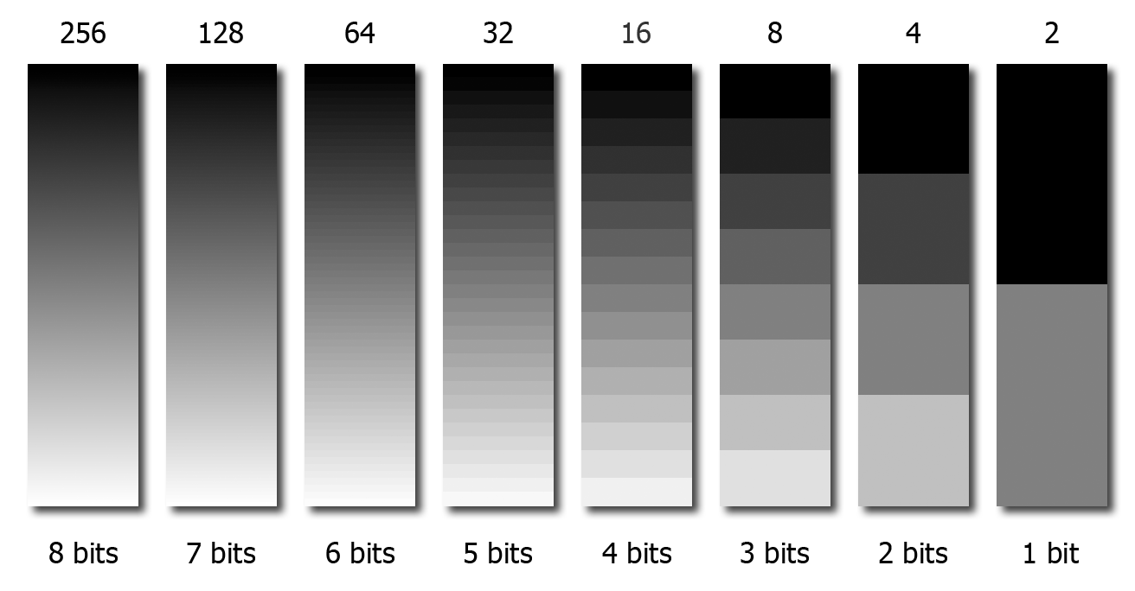
Intensity Level Resolution
16
Notes:
16

Slide 17
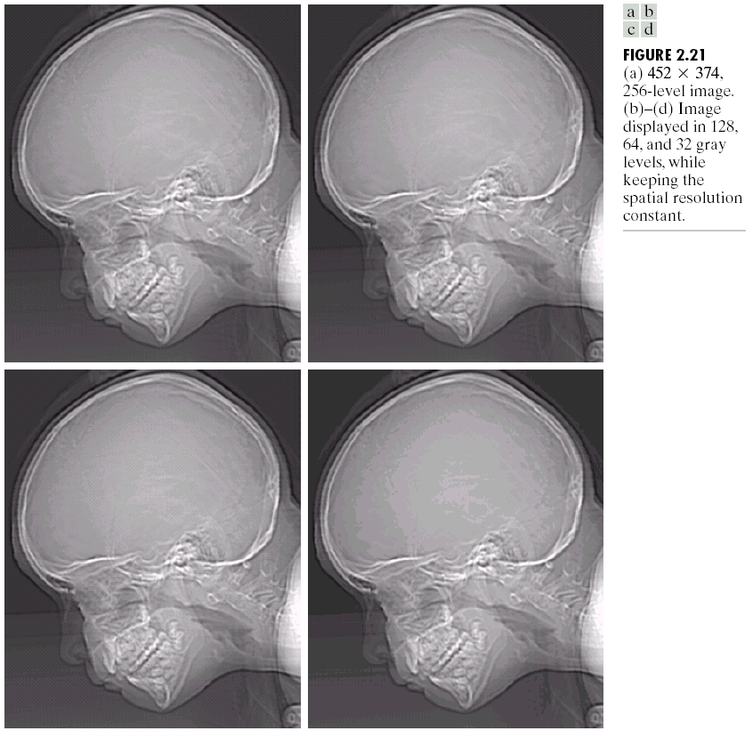
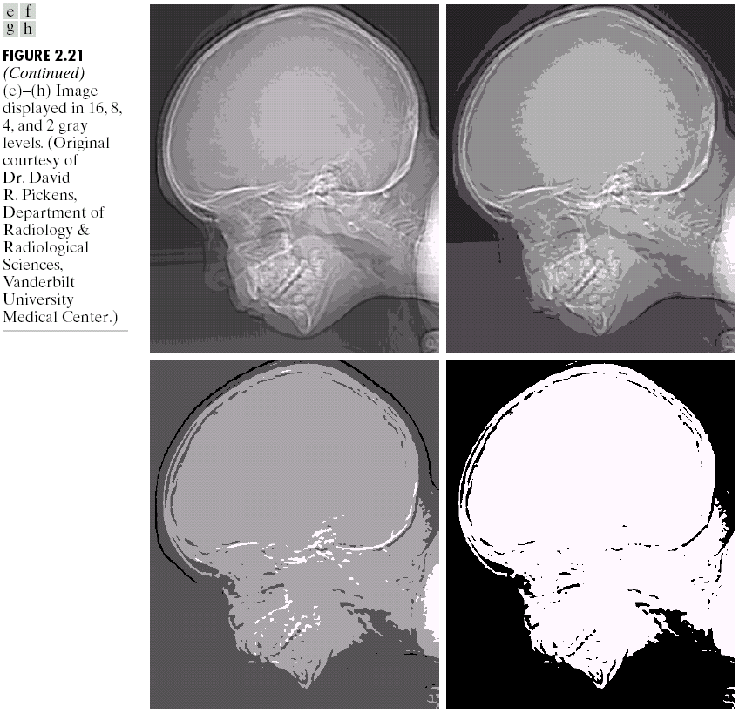
Intensity Level Resolution
256 grey levels (8 bits per pixel)
128 grey levels (7 bpp)
64 grey levels (6 bpp)
32 grey levels (5 bpp)
16 grey levels (4 bpp)
8 grey levels (3 bpp)
4 grey levels (2 bpp)
2 grey levels (1 bpp)
17
Notes:
17

Slide 18
Resolution: How much is enough?
How many samples and gray levels are required for a good approximation?
  Quality of an image depends on number of pixels and gray-level number
  The more these parameters are increased, the closer the digitized array approximates the original image
  But: Storage & processing requirements increase rapidly as a function of N, M, and k
18
Notes:
18

Slide 19

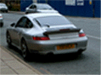
Resolution: How much is enough?
Depends on what is in the image and what you would like to do with it
19
Notes:
19

Slide 20
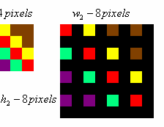
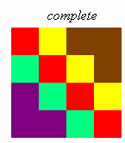
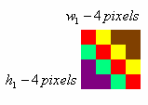
Image Resizing
Pixel replication
[1 2 3 4 5]
[1 1 2 2 3 3 4 4 5 5] (One step)
[1 1 1 2 2 2 3 3 3 4 4 4 5 5 5] (Two step)
20
Notes:
20

Slide 21


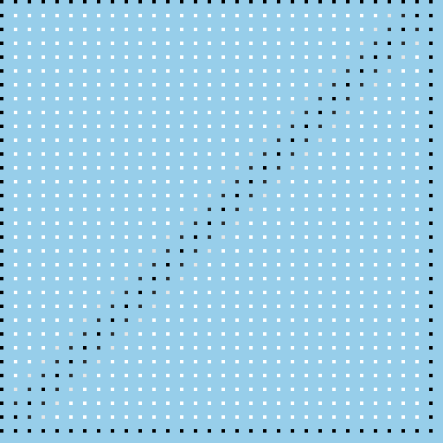

Enlarging an Image
Example:
zoom this image 4x to get this image.
.
.
.
Start with a blank image 4 times the linear dimensions of the original.
Fill in every 4th pixel in every 4th row with the original pixel values.
21
Notes:
21

Slide 22
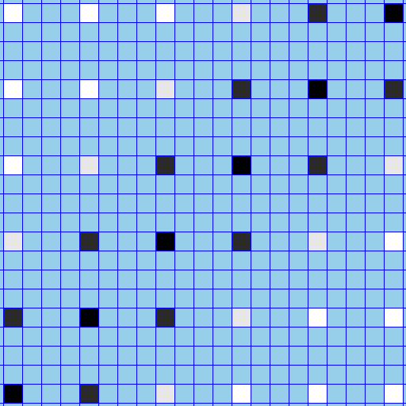
Enlarging an Image
…
…
…
…
…
…
Detail showing every 4th pixel in every 4th row with the original pixel values.
22
Notes:
22

Slide 23

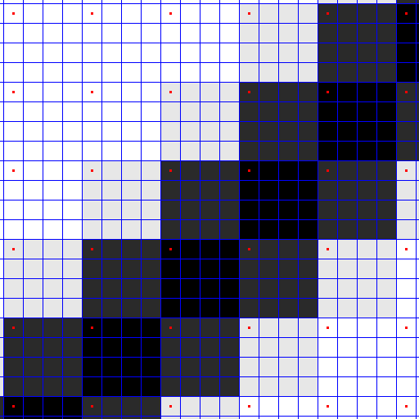
Enlarging an Image
Replicate the values
23
Notes:
23

Slide 24
Image Interpolation
Nearest neighbour interpolation
  Simple but produces undesired artefacts
Bilinear Interpolation
  Contribution from 4 neighbors
Bicubic Interpolation
  Contribution from 16 neighbors
24
Notes:
24

Slide 25
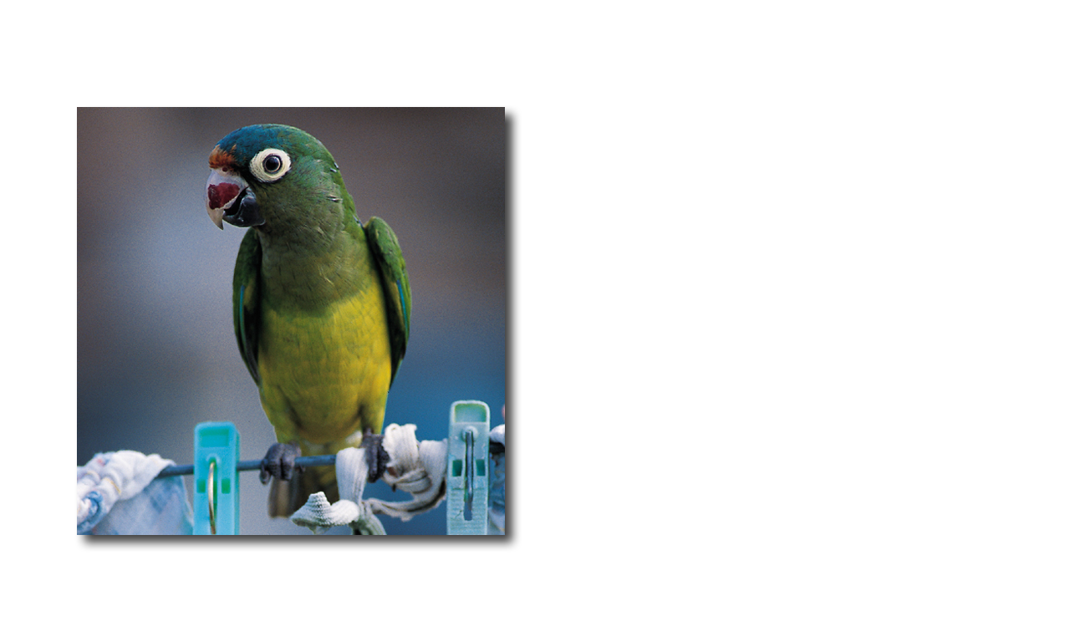
Interpolation: Comparison
We’ll enlarge this image by a factor of 4 …
… via bilinear interpolation and compare it to a nearest neighbor enlargement.

Slide 26
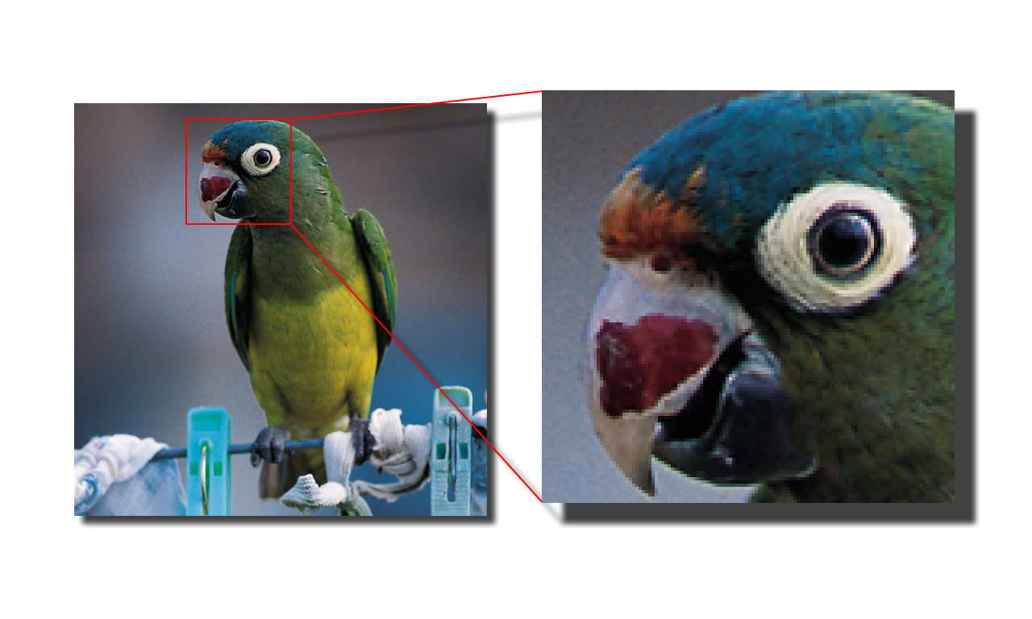
Interpolation: Comparison
Original Image
To better see what happens, we’ll look at the parrot’s eye.

Slide 27
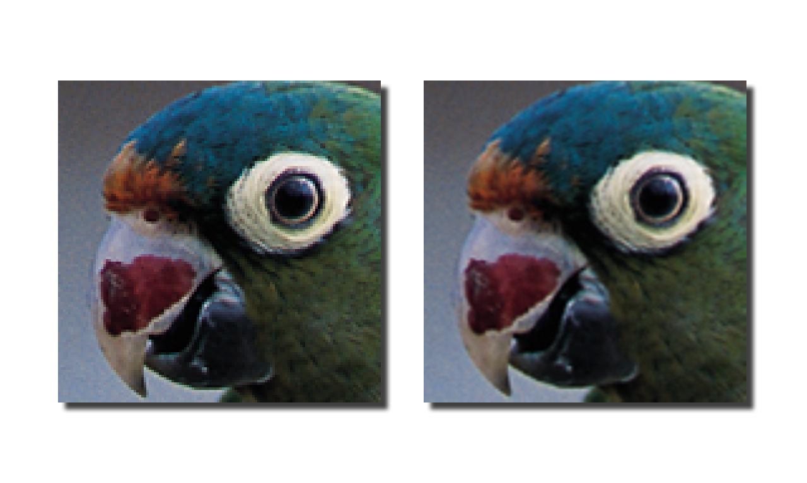
Interpolation: Comparison
Pixel replication
Bilinear interpolation

Slide 28
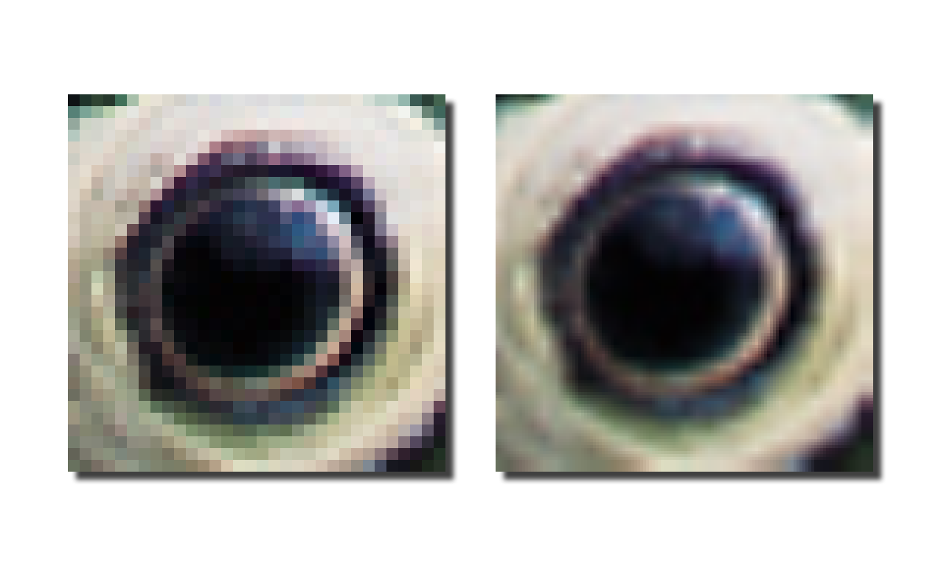
Interpolation: Comparison
Pixel replication
Bilinear interpolation

